Slide 1
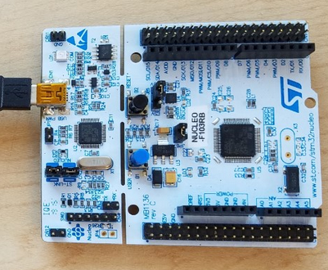
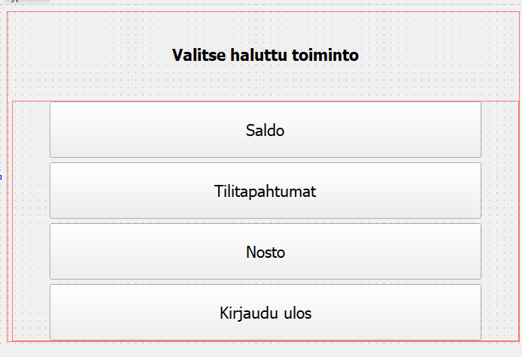
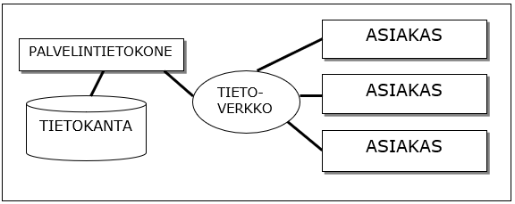
Bank Simulator
Matias Kauranen, Antti Kurkinen, Arttu Kääriäinen, Juhani Koski, TVT21SPL
Information Technology, Product and Device Design
Introduction
The focus of this project was to make a Bank Simulator, which could be used through a Qt widget based application, and to learn skills required to develop such programs.
The system structure is the client server model. (See the figure 1 below)
Objectives
The basic aims included a debit account, protected by a PIN code and a card ID. The user could ”withdraw” 20,40,50 or 100 euros and check the account balance.
The system is controlled through a Qt widget application, which is connected to a database.
The secondary aims were to make a credit account, that the user could withdraw any amount they wished and that the REST API included all the CRUD operations.
FIGURE 1. The Client Server model
Methods
The microcontroller used in the project was the STM32 Nucleo-64. (See the figure 3 on the right) Purpose of the MCU was to simulate a RFID reader. When the card ID and password were correct the user could access the ATM main menu. (See the figure 2 below.)
The user could then check account balance, history, withdraw cash or log out.
All the actions then will be updated to the database.
FIGURE 2. The Main Menu
Results
The application worked as planned. After the user withdraws cash, checks account balance or checks account history, it updates the database immediately.
All the secondary objectives were also achieved. Credit account and all the CRUD operations worked as intended.
FIGURE 3. STM32 Nucleo-64
Conclusions
Bank simulator was a great success. It taught a lot about programming, especially connecting frontend and backend to a database, and how these different software development applications work with each other.
References
1.STM32 Nucleo-64 datasheet Source:https://www.st.com/resource/en/user_manual/dm00105823-stm32-nucleo64-boards-mb1136-stmicroelectronics.pdf
Software Application Project
ECTS Credits: 6
Date of Publication: 2022, Spring
Instructor: Teemu Leppänen

